Slide 1
MARKETING AND RETAIL ANALYTICS
MARKET BASKET ANALYSIS
Created by Shubhasree Sarkar

Slide 2
Problem Statement
A Grocery Store shared the transactional data with you. Your job is to identify the most popular combos that can be suggested to the Grocery Store chain after a thorough analysis of the most commonly occurring sets of menu items in the customer orders. The Store doesn’t have any combo meals.
Can you suggest the best combo meals?
Dataset provided –
Tools used –
Tableau -https://public.tableau.com/app/profile/shubhasree.sarkar/viz/MBA_mra2/Yearwisecount?publish=yes
Python
KNIME

Slide 3
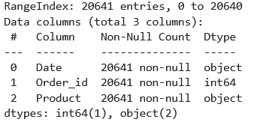
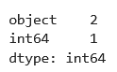
About data
Interpretation
The dataset contains 3 variables and 20641 records-
Categorical type/object type – 2
Integer type – 1
There are no missing values but 4730 duplicate values are present

Slide 4
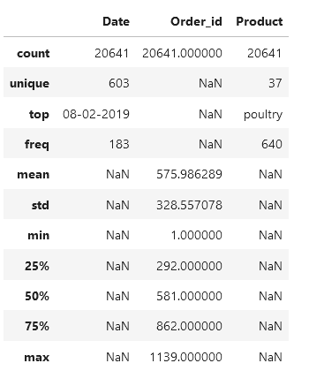
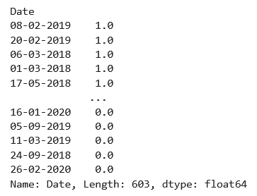
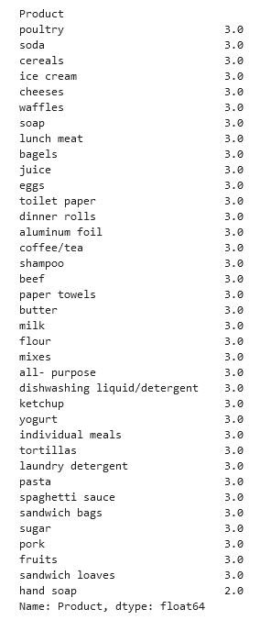
About data
DATA SUMMARY- CONTINUOUS and VARIABLES

Slide 5
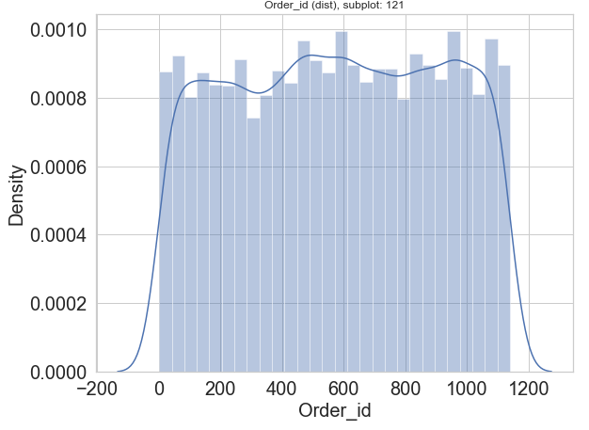
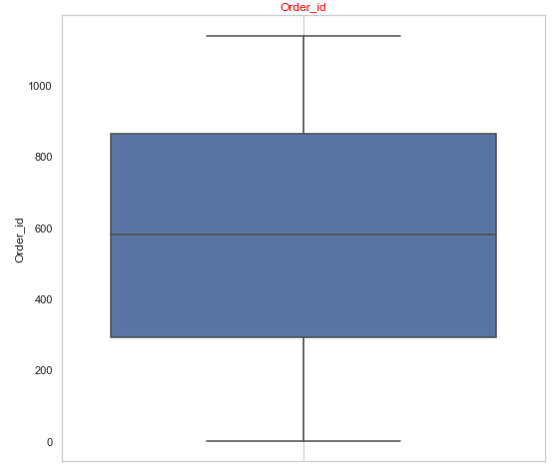
Exploratory data analysis - Univariate
QUANTITY ORDERED
From the above two diagrams we can confirm that the quantities ordered have presence of outliers, with majority of the quantity volumes between 20-50 units. Hence, the data is not normally distributed.

Slide 6
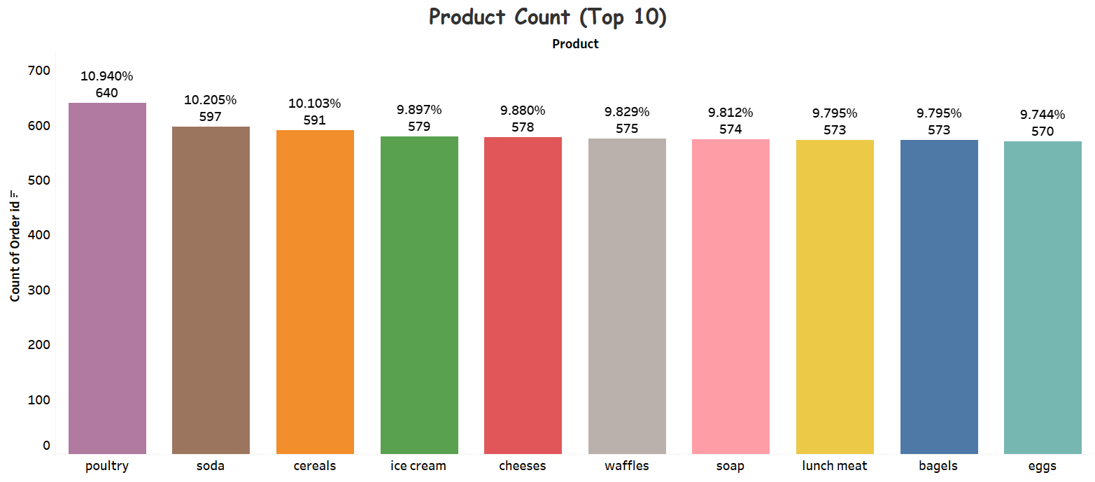
Exploratory data analysis - Univariate
From the above Bar plot, regarding Top 10 Product count, we can conclude that the Poultry contribute for the maximum share (10.940%), followed by Soda (10.205%)

Slide 7
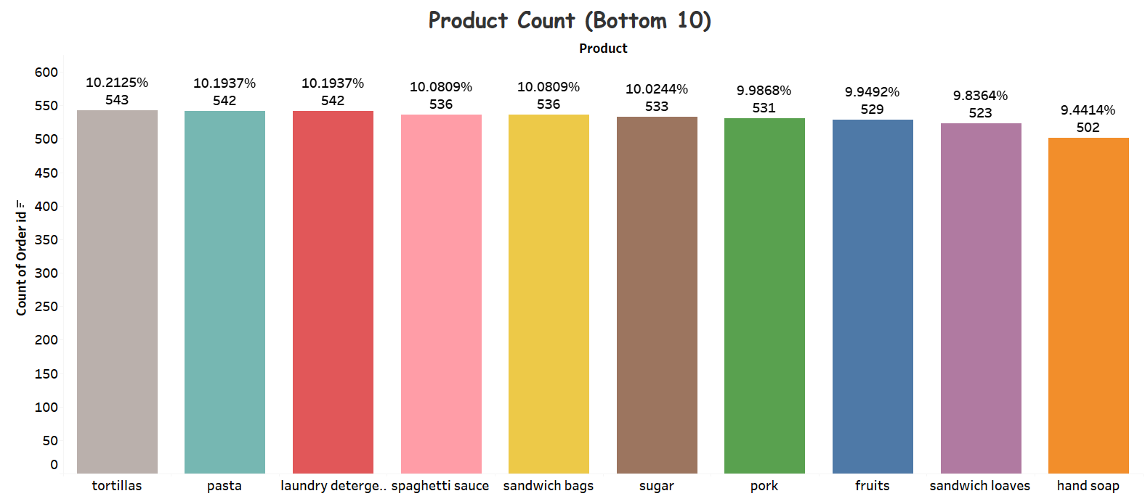
Exploratory data analysis - Univariate
From the above Bar plot, regarding Bottom 10 Product count, we can conclude that the Handsoap contribute for the minimum share (9.4414%), followed by Sandwich Loaves (9.8364%)

Slide 8
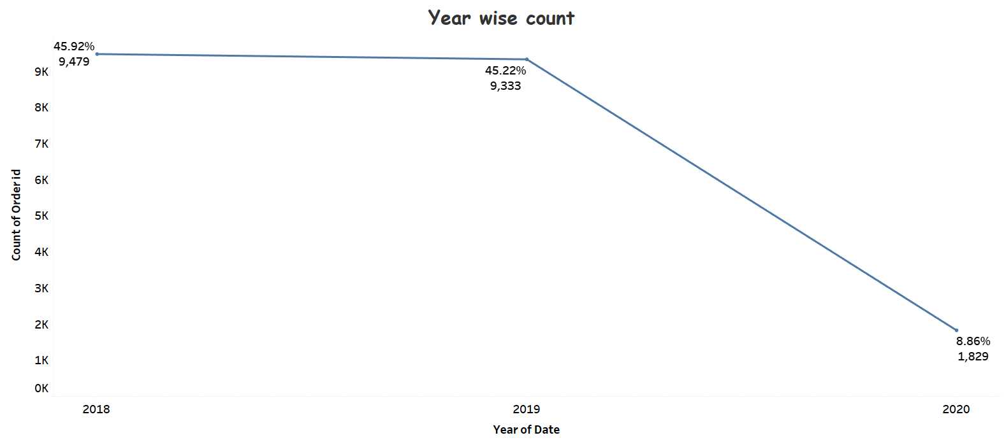
Exploratory data analysis – Bivariate Analysis
From the above graph we can confirm that year 2018 has the highest no. of orders (45.92%)in terms of production in various segments which gradually decreased , becoming lowest in 2020(8.86%)

Slide 9
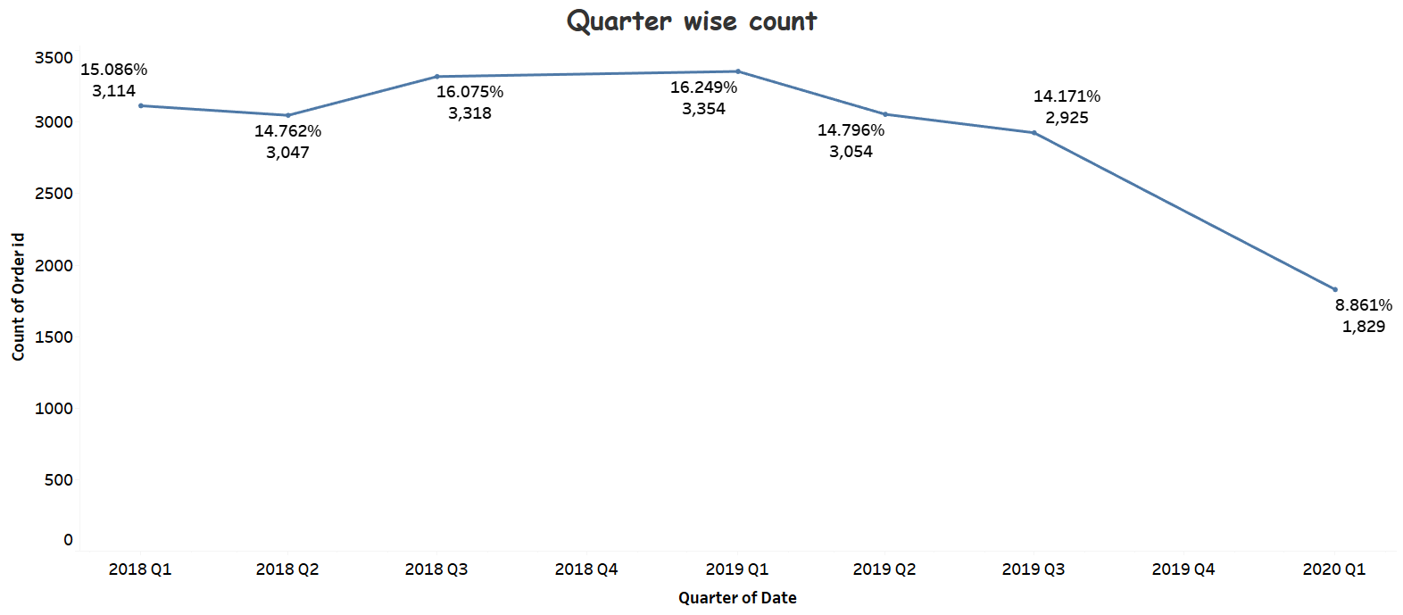
Exploratory data analysis – Bivariate Analysis
From the above graph we can confirm that from 2018 Q1 till 2019 Q1, the order-count have increased from 15.086% to 16.249%(the highest), but it eventually decreased to 8.861% on 2021 Q1.

Slide 10
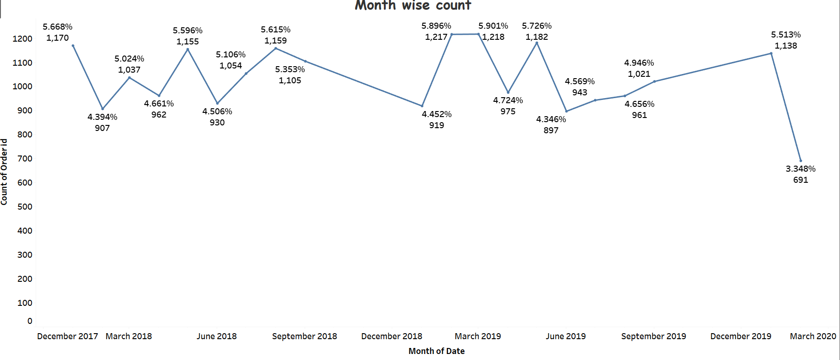
Exploratory data analysis – Bivariate Analysis
From the above graph we can confirm that overall the month wise order count has been fluctuating with irregular increase and decrease over the period starting from January 2018 till March 2020.In between, it has been highest during March 2019 and lowest during March 2020.

Slide 11
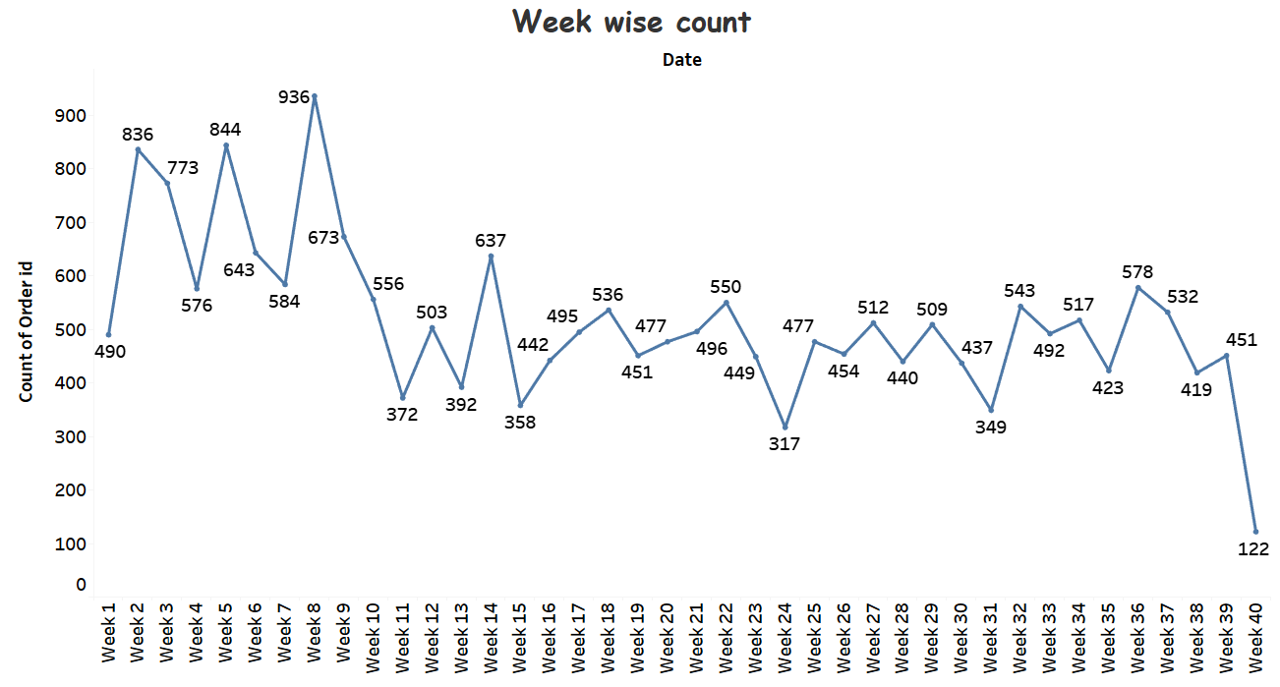
Exploratory data analysis – Bivariate Analysis
From the above graph we can confirm that over the weeks from week 0 to week 40, the order count has been fluctuating overall. In between, during week 8, it has been the highest while during week 40, it has been the lowest.

Slide 12
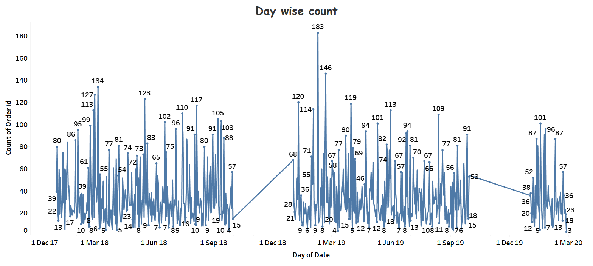
Exploratory data analysis – Bivariate Analysis
From the above graph we can confirm that over the days, 8Th February, 2019 has the highest orders seen.

Slide 13
WHAT is Market basket analysis?
Market basket analysis is a data mining technique used by retailers to increase sales by better understanding customer purchasing patterns. It involves analysing large data sets, such as purchase history, to reveal product groupings, as well as products that are likely to be purchased together.
The adoption of market basket analysis was aided by the advent of electronic point-of-sale (POS) systems. Compared to handwritten records kept by store owners, the digital records generated by POS systems made it easier for applications to process and analyse large volumes of purchase data.
Examples of market basket analysis
The Amazon website employs a well-known example of market basket analysis. On a product page, Amazon presents users with related products, under the headings of “Frequently bought together” and “Customers who bought this item also bought.”
Market basket analysis also applies to bricks-and-mortar stores. If analysis showed that magazine purchases often include the purchase of a bookmark (which could be considered an unexpected combination, since the consumer did not purchase a book), then the book store might place a selection of bookmarks near the magazine rack.

Slide 14
market basket analysis
Types of market basket analysis
There are two types of market basket analysis:
Predictive market basket analysis: This type considers items purchased in sequence to determine cross-sell
Differential market basket analysis: This type considers data across different stores, as well as purchases from different customer groups during different times of the day, month or year. If a rule holds in one dimension (like store, time period or customer group), but does not hold in the others, analysts can determine the factors responsible for the exception. These insights can lead to new product offers that drive higher sales.
Benefits of market basket analysis
Market basket analysis can increase sales and customer satisfaction. Using data to determine that products are often purchased together, retailers can optimize product placement, offer special deals and create new product bundles to encourage further sales of these combinations.
These improvements can generate additional sales for the retailer, while making the shopping experience more productive and valuable for customers. By using market basket analysis, customers may feel a stronger sentiment or brand loyalty toward the company.

Slide 15
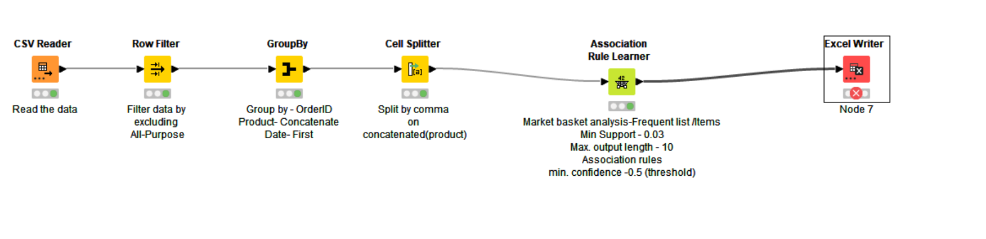
KNIME WORKFLOW

Slide 16
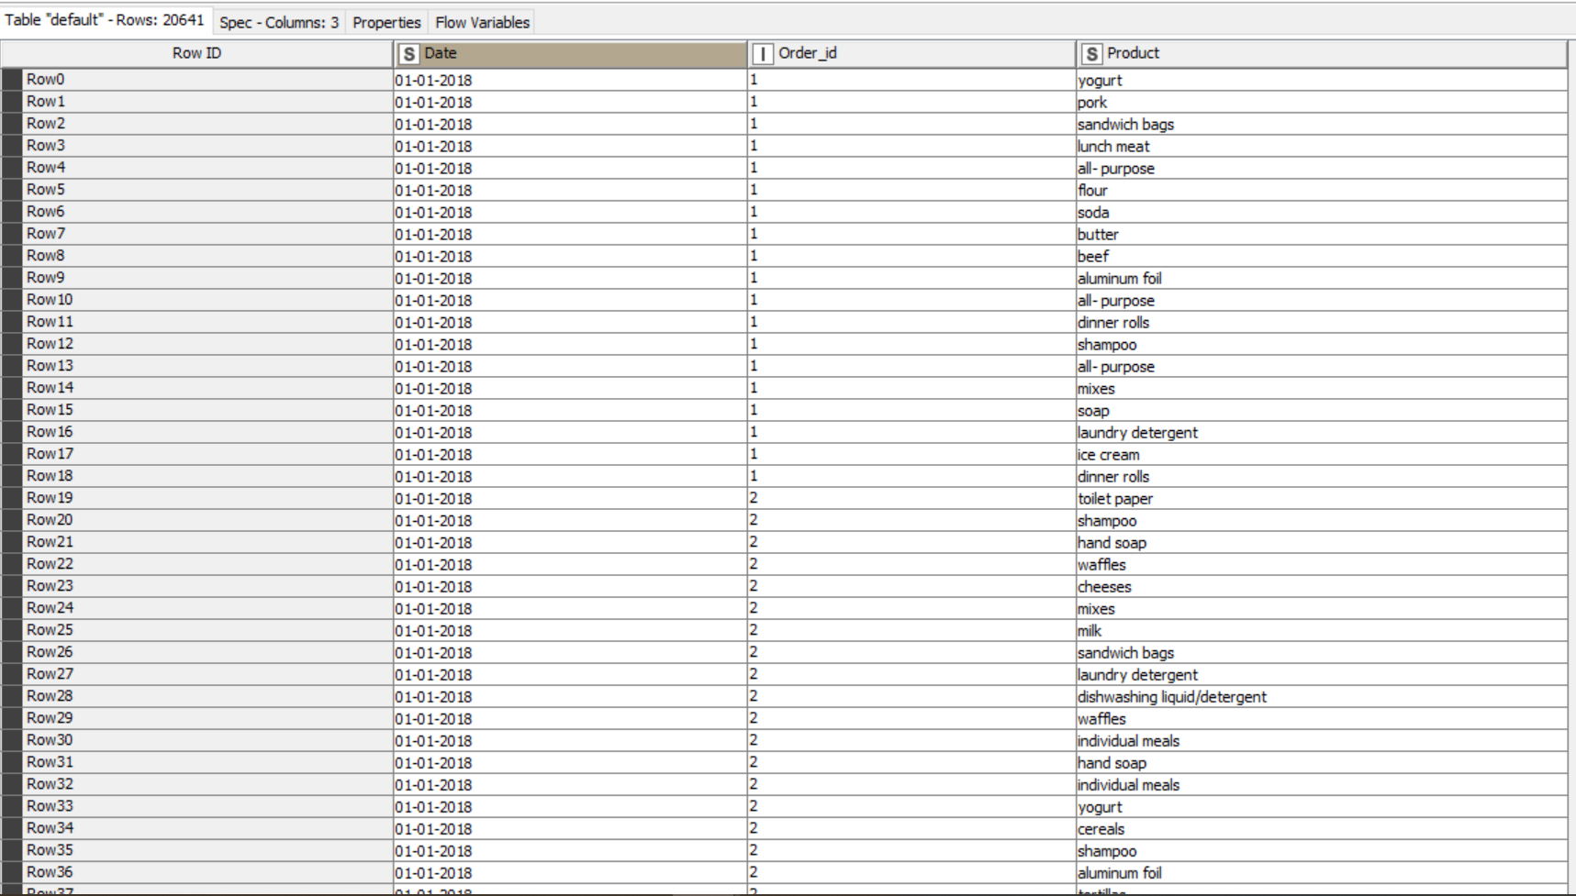
DATA Load
Total no. of rows in the dataset as shown above is 20641

Slide 17
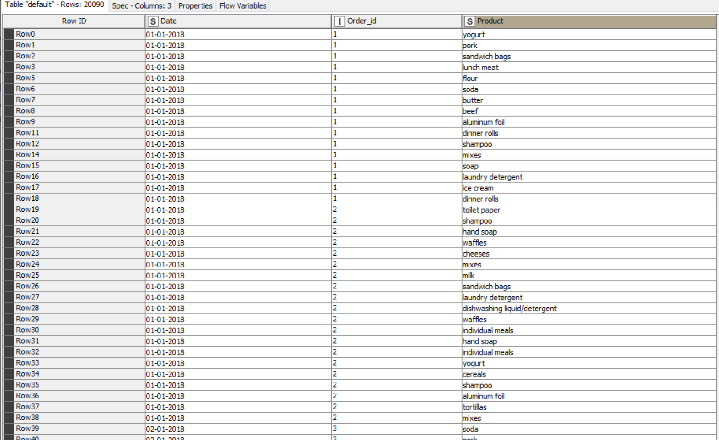
Filtered data
We have set a row filtering based on exclusion of the category – All Purpose.
Total no. of filtered rows in the dataset as shown above is 20090

Slide 18
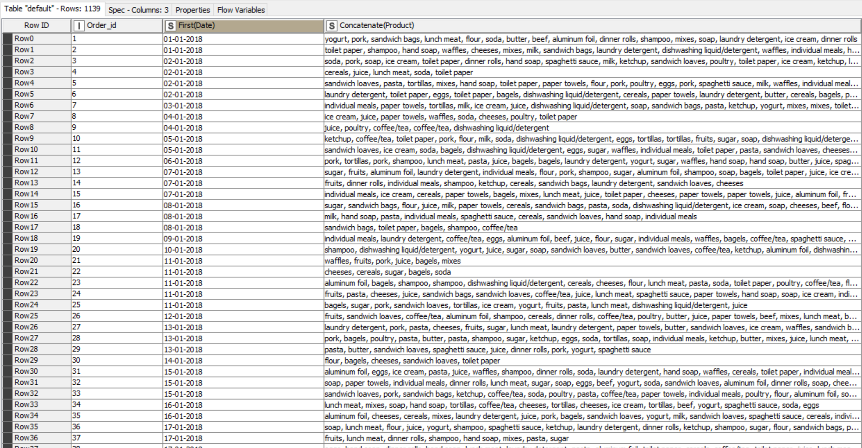
Grouped data
In this step, we have grouped the data by Order ID
We applied manual aggregation rules-
Product- Concatenation
Date- Sorted (First)
No. of Rows- 1139

Slide 19
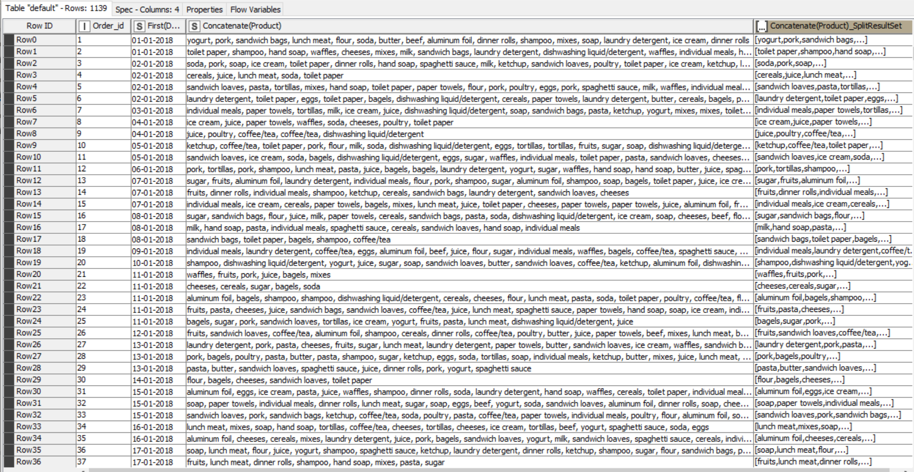
Cell splitter
In this step, we have used cell splitter based on the concatenated - product
Output rows – 1139
New column created- Concatenated_SplitResultSet
All the duplicates are being removed

Slide 20
ASSOCIATION RULES
In market basket analysis, association rules are used to predict the likelihood of products being purchased together. Association rules count the frequency of items that occur together, seeking to find associations that occur far more often than expected.
Let I = {I1, I2,…, Im} be an itemset. Let D, the data, be a set of database transactions where each transaction T is a nonempty itemset such that T ⊆ I. Each transaction is associated with an identifier, called a TID(or Tid). Let A be a set of items(itemset). T is the Transaction which is said to contain A if A ⊆ T. An Association Rule is an implication of the form A ⇒ B, where A ⊂ I, B ⊂ I, and A ∩B = φ.
The rule A ⇒ B holds in the data set(transactions) D with supports, where ‘s’ is the percentage of transactions in D that contain A ∪ B (that is the union of set A and set B, or, both A and B). This is taken as the probability, P(A ∪ B). Rule A ⇒ B has confidence c in the transaction set D, where c is the percentage of transactions in D containing A that also contains B. This is taken to be the conditional probability, like P(B|A). That is,
support(A⇒ B) =P(A ∪ B)
confidence(A⇒ B) =P(B|A)
Rules that satisfy both a minimum support threshold (called min sup) and a minimum confidence threshold (called min conf ) are called “Strong”.
Confidence(A⇒ B) = P(B|A) = support(A ∪ B) /support(A) = support count(A ∪ B) / support count(A)

Slide 21
Types of market basket analysis
Support: This metric is indicative of how frequently the products appear in the data set. For example, if we have ten transactions, and pens appear in seven transactions, then the support is 7/10, which is 70%. High support percentages are preferable, as they indicate that the association is likely to apply to a large number of future transactions.
Support (X -> Y) = Support (X ∪ Y)
Confidence: This metric is indicative of the probability that transactions that contain a certain product (X) will also contain product (Y) {X -> Y}. So the confidence of X -> Y = Pr(X&Y) / Pr(X). The issue with this metric is that the confidence might be inflated if both X and Y are popular or frequently purchased products. So, we need to find a way to control the popularity of Y.
Confidence (X -> Y) = Support (X -> Y) / Support (X)
Lift: This metric is indicative of the probability of Y being purchased when X is purchased while controlling the popularity of Y. To control the popularity of Y, we need to measure the probability of all the products in a rule occurring together and divide it by the product of the probabilities of the products as if there was no association between them. For example, if milk and cheese occurred together in 2% of all transactions, milk in 15% of transactions and cheese in 5% of transactions, then the lift is: 0.02 / (0.15 * 0.05) = 2.7. A lift value that is equal to one indicates that products X and Y are independent of each other. We should look for lift values greater than one because these values mean that item Y is likely to be bought if item X is bought. The larger the lift, the greater the link between two products.
Lift (X -> Y) = Support (X -> Y) / Support (X) * Support (Y)

Slide 22
ASSOCIATION RULES
Let I = {I1, I2,…, Im} be an itemset. Let D, the data, be a set of database transactions where each transaction T is a nonempty itemset such that T ⊆ I. Each transaction is associated with an identifier, called a TID(or Tid). Let A be a set of items(itemset). T is the Transaction which is said to contain A if A ⊆ T. An Association Rule is an implication of the form A ⇒ B, where A ⊂ I, B ⊂ I, and A ∩B = φ.
The rule A ⇒ B holds in the data set(transactions) D with supports, where ‘s’ is the percentage of transactions in D that contain A ∪ B (that is the union of set A and set B, or, both A and B). This is taken as the probability, P(A ∪ B). Rule A ⇒ B has confidence c in the transaction set D, where c is the percentage of transactions in D containing A that also contains B. This is taken to be the conditional probability, like P(B|A). That is,
support(A⇒ B) =P(A ∪ B)
confidence(A⇒ B) =P(B|A)
Rules that satisfy both a minimum support threshold (called min sup) and a minimum confidence threshold (called min conf ) are called “Strong”.
Confidence(A⇒ B) = P(B|A) = support(A ∪ B) /support(A) = support count(A ∪ B) / support count(A)
Generally, Association Rule Mining can be viewed in a two-step process:-
1. Find all Frequent itemsets: By definition, each of these itemsets will occur at least as frequently as a pre-established minimum support count, min sup.
2. Generate Association Rules from the Frequent itemsets: By definition, these rules must satisfy minimum support and minimum confidence.
Association Rule Mining is primarily used when you want to identify an association between different items in a set, then find frequent patterns in a transactional database, relational databases(RDBMS).

Slide 23
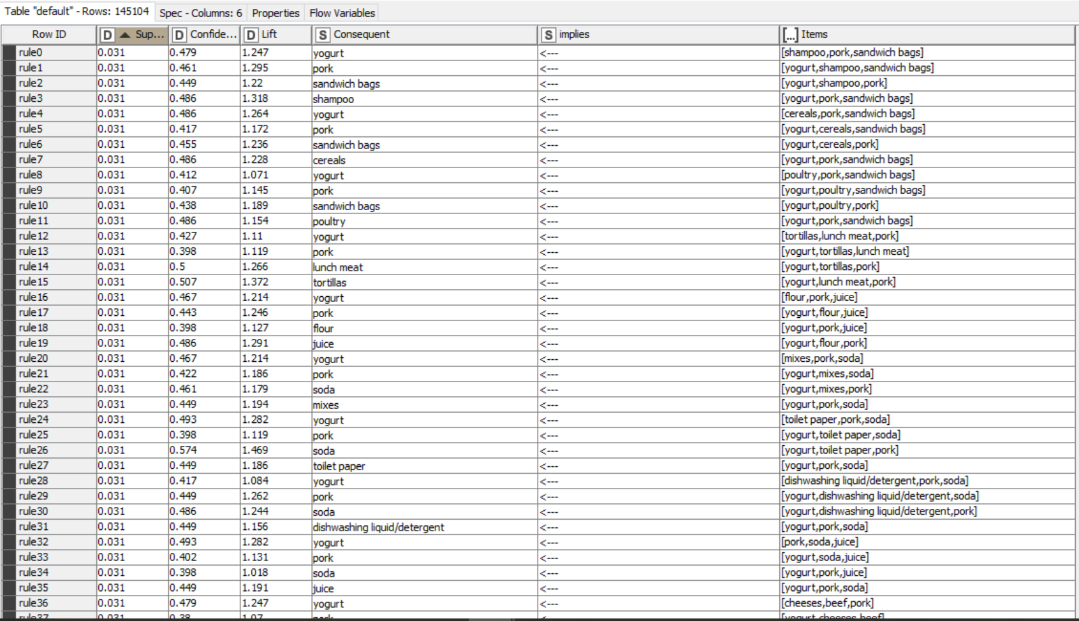
Association rules based output
In this step, we have used the association rules with the following set metrices-Support, confidence and Lift
Support value – 0-1(here 0.03)- defines 3% sell of a product from overall transactions
Confidence – Miniimum – 0.05 – Threshold values
No of records- 145104

Slide 24
INFERENCES FROM MARKET BASKET ANALYSIS
As per the total process of Market Basket Analysis being concerned, it has created a multiple set of rules based on the threshold limit that we have set earlier in the Association Rule Learner Node. By considering the lift values for the ones that are higher, it is better to recommend the product to the customers.
As we can see, a new column being created named Consequent, which contains all the recommended products and based on the sorted (descending) lift values from higher to lower, we have created recommendations to the customers

Slide 25
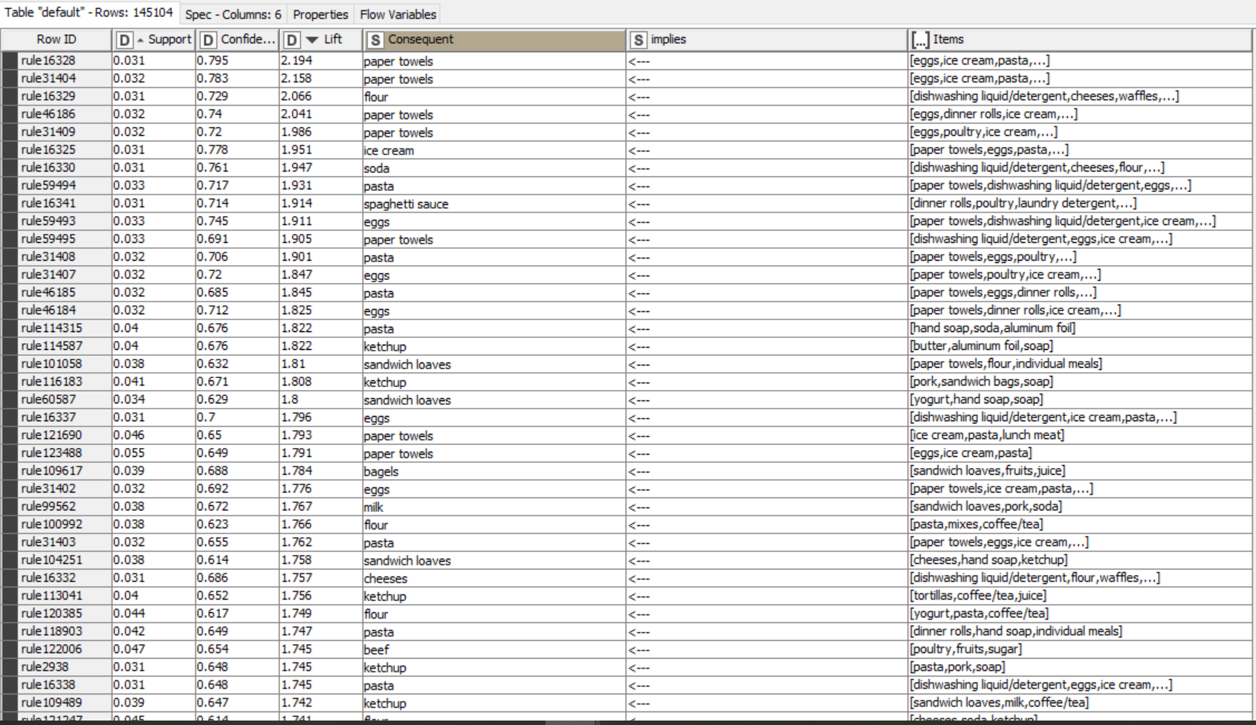
Association rules based output
Output based on Sorted Lift (Descending)

Slide 26
RECOMMENDATIONS FROM MARKET BASKET ANALYSIS
Based on the inferences drawn, several recommendations can be made-
We can suggest combo offer – based on lift value, we can suggest paper towels with eggs, ice cream, pasta or flour with cheeses and waffles, etc.
During the year , 2020, the order count for the items failed drastically, probably due to the onset of Pandemic being hit on a global level.
Purchase of more Paper towels, is probably due to increase in order during that time
We have seen, over the years, Poultry products are being ordered mostly followed by Soda, so we can try to increase the margin by increasing the price of the same. ON the contrary , we have seen handsoaps being ordered the least, which is why we can try provide them in discounts or combo offers (Buy 2 get 1 free)
We can apply the similar combos for fruits and sandwich loaves

Slide 27
THANK YOU

